Slide 1
Where are Self-Supervised Models Headed?
Daniel Khashabi
Notes:
Before I start, let me just say that: - It’s an honor to be here; I appreciate this opportunity - excited to share my research with y’all.
If you have any clarification questions, please interrupt me; otherwise, let’s delay open-ended questions till after the talk.
# Alternative titles:
Inching toward generality
Quest toward generality

Slide 2
Self-Supervised Models
are predictive models of the world!

Slide 3
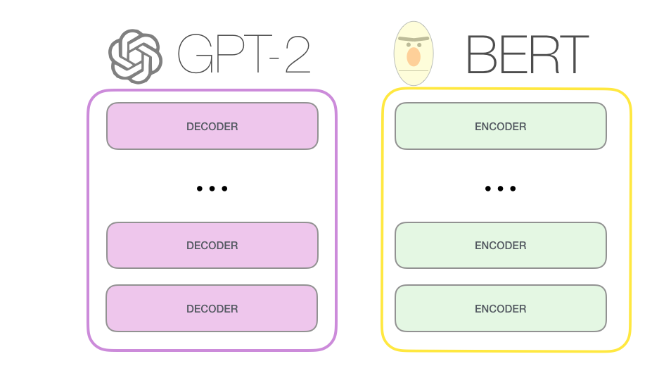
Large Language Models
[Bengio et al. ‘04, Peters et al. ‘18, Raffel et al. ‘20, Brown et al. ’20, many others]
Notes:
Need examples that shows how language models can fail in a variety of setups and generate things that may be problematic.

Slide 4

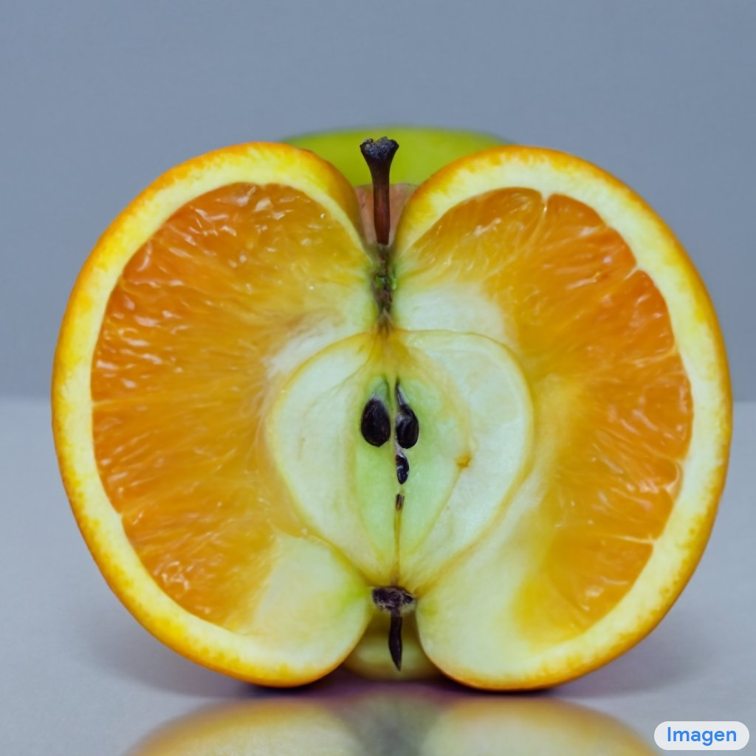
Image-Text Models
an invisible man, wearing glasses and sitting at a desk in front of a computer"
one piece of fruit that's apple on the outside, orange texture on the inside, cut in half
https://openai.com/dall-e-2/
https://imagen.research.google/

Slide 5


Scaling Self-Supervised Models
Larger pre-training datasets
cheap freely-available text
1GB
10GB
10TB
Notes:
These are some applications of language understanding for the context, and many of these have seem performance improvements in the past few years due to advent of deep learning.
So much so that some people got the impression that AI systems are closing in on human intelligence and …
Under the hood, these improvements are due to new developments on how neural networks are supervised with freely-available data, such as raw web text.
To be more concrete,
- self-supervised learning → gives some level of generality, but not enough
- increasingly large pre-training data
- increasingly larger models
Progresses are made, but we have a long way to go:
- LMs have an understanding of language structure → making it a useful representation tool
We need more:
- must generalize to many new tasks with essentially no retraining
- explaining, rationalizing and understanding the decisions
- imagining possible alternatives that haven’t happened yet
- planning actions for future
- models that actively revise their knowledge/decisions based on the feedback of their environment (and that includes both successes and failures)
- sharing our social and ethical values …
So in order to introduce such attributes we need a lot of work and progress to capture these.
- Tasks that we want to solve They are hard to control
During my PhD, I have taken several steps toward this broader goal, along these three methodological directions:
- ….
Eval
Repr
Symbolic
In this talk, I am going to focus on three projects specifically:

Slide 6
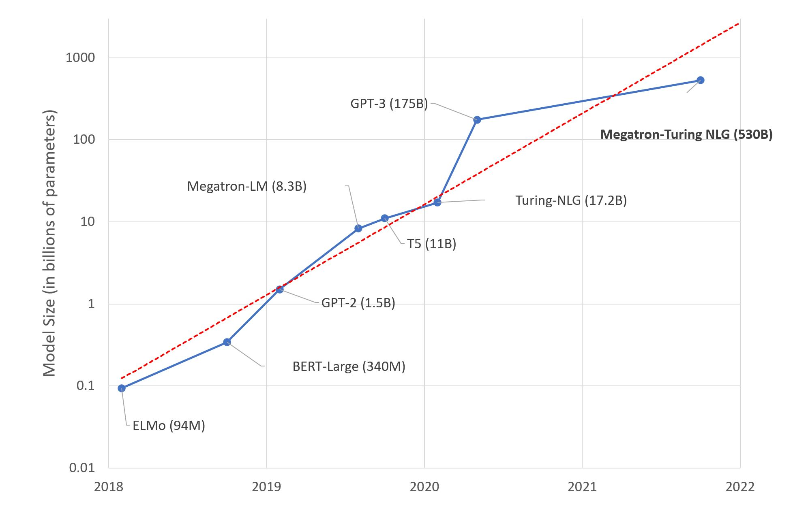
Scaling Self-Supervised Models
Larger pre-training datasets
Larger models
Notes:
These are some applications of language understanding for the context, and many of these have seem performance improvements in the past few years due to advent of deep learning.
So much so that some people got the impression that AI systems are closing in on human intelligence and …
Under the hood, these improvements are due to new developments on how neural networks are supervised with freely-available data, such as raw web text.
To be more concrete,
- self-supervised learning → gives some level of generality, but not enough
- increasingly large pre-training data
- increasingly larger models
Progresses are made, but we have a long way to go:
- LMs have an understanding of language structure → making it a useful representation tool
We need more:
- must generalize to many new tasks with essentially no retraining
- explaining, rationalizing and understanding the decisions
- imagining possible alternatives that haven’t happened yet
- planning actions for future
- models that actively revise their knowledge/decisions based on the feedback of their environment (and that includes both successes and failures)
- sharing our social and ethical values …
So in order to introduce such attributes we need a lot of work and progress to capture these.
- Tasks that we want to solve They are hard to control
During my PhD, I have taken several steps toward this broader goal, along these three methodological directions:
- ….
Eval
Repr
Symbolic
In this talk, I am going to focus on three projects specifically:

Slide 7
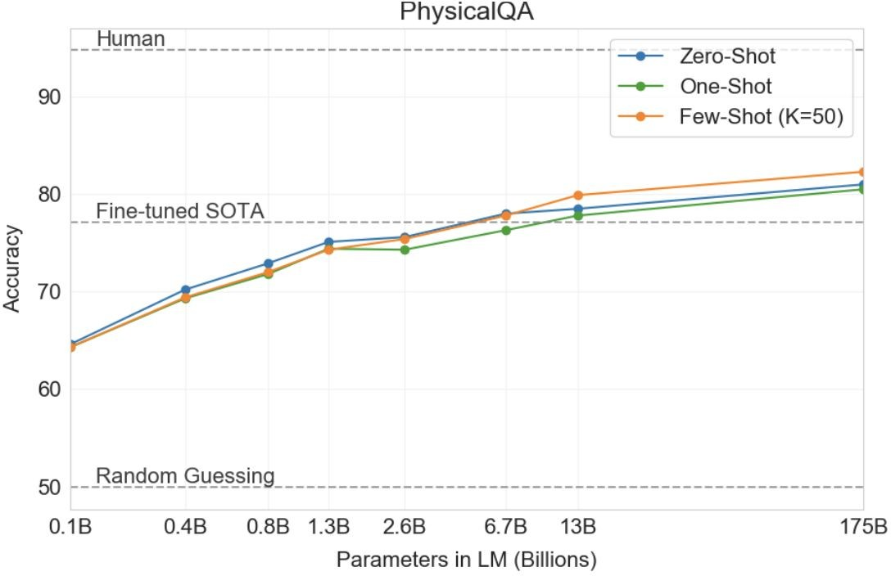
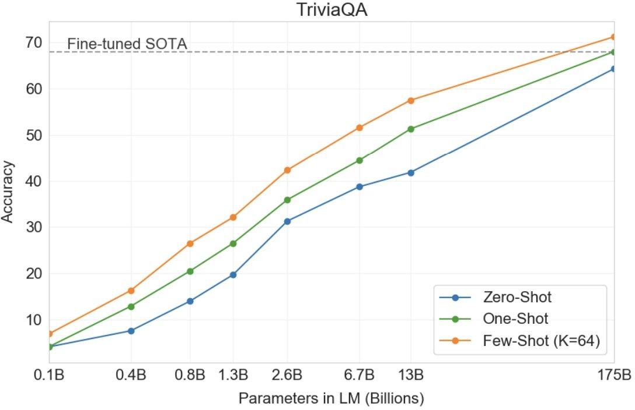
Scaling Self-Supervised Models
35
Brown et al. 2020. “Language Models are Few-Shot Learners”

Slide 8
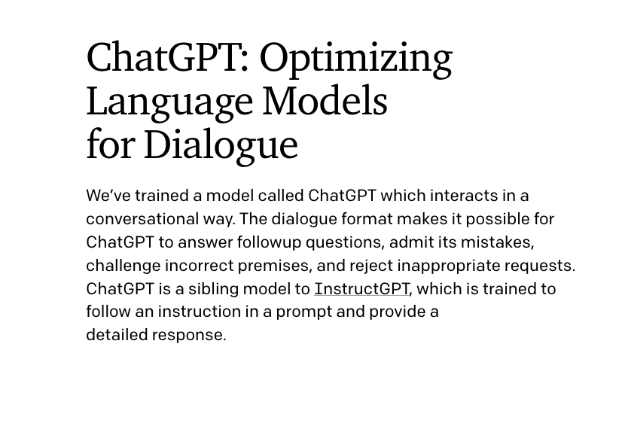

Slide 9
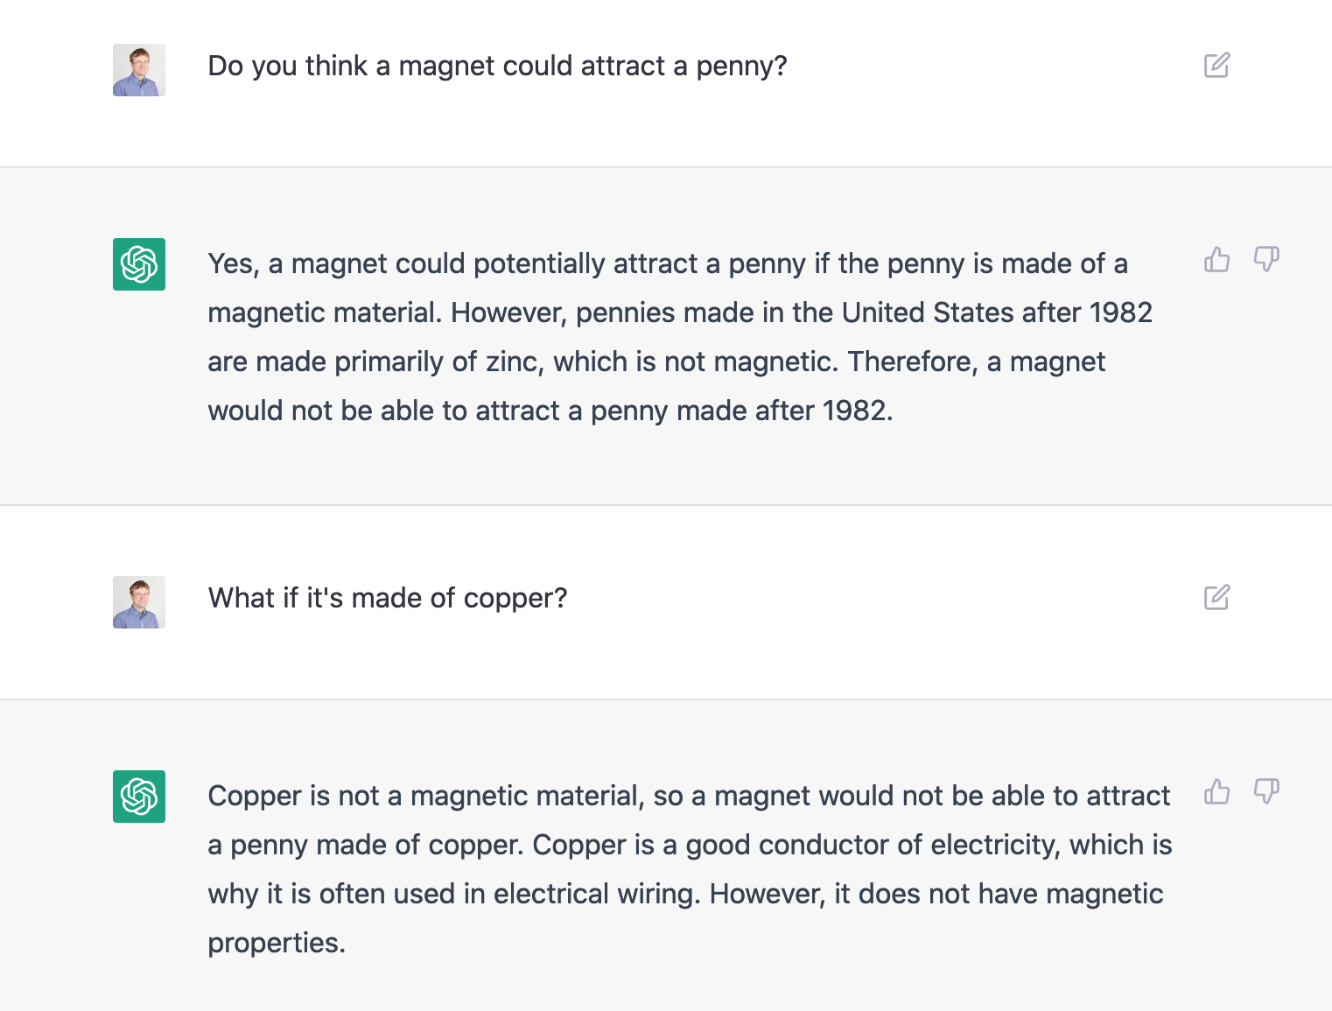

Slide 10
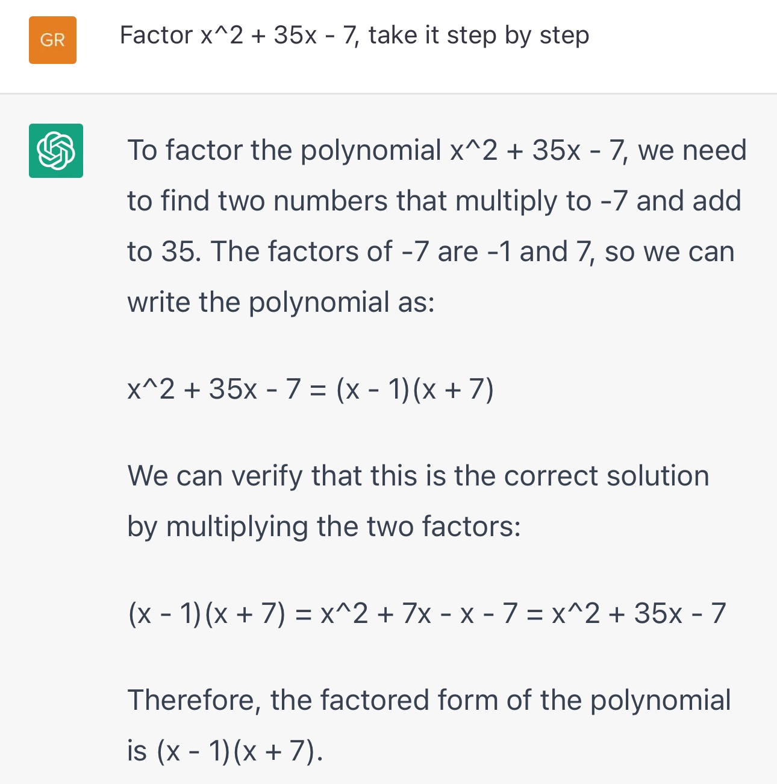

Slide 11

"Write George Washington's farewell address as if it was delivered by a pirate"

Slide 12
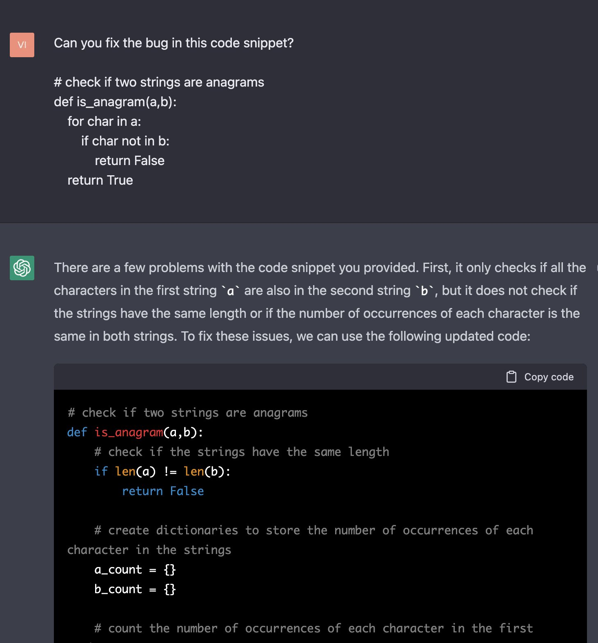
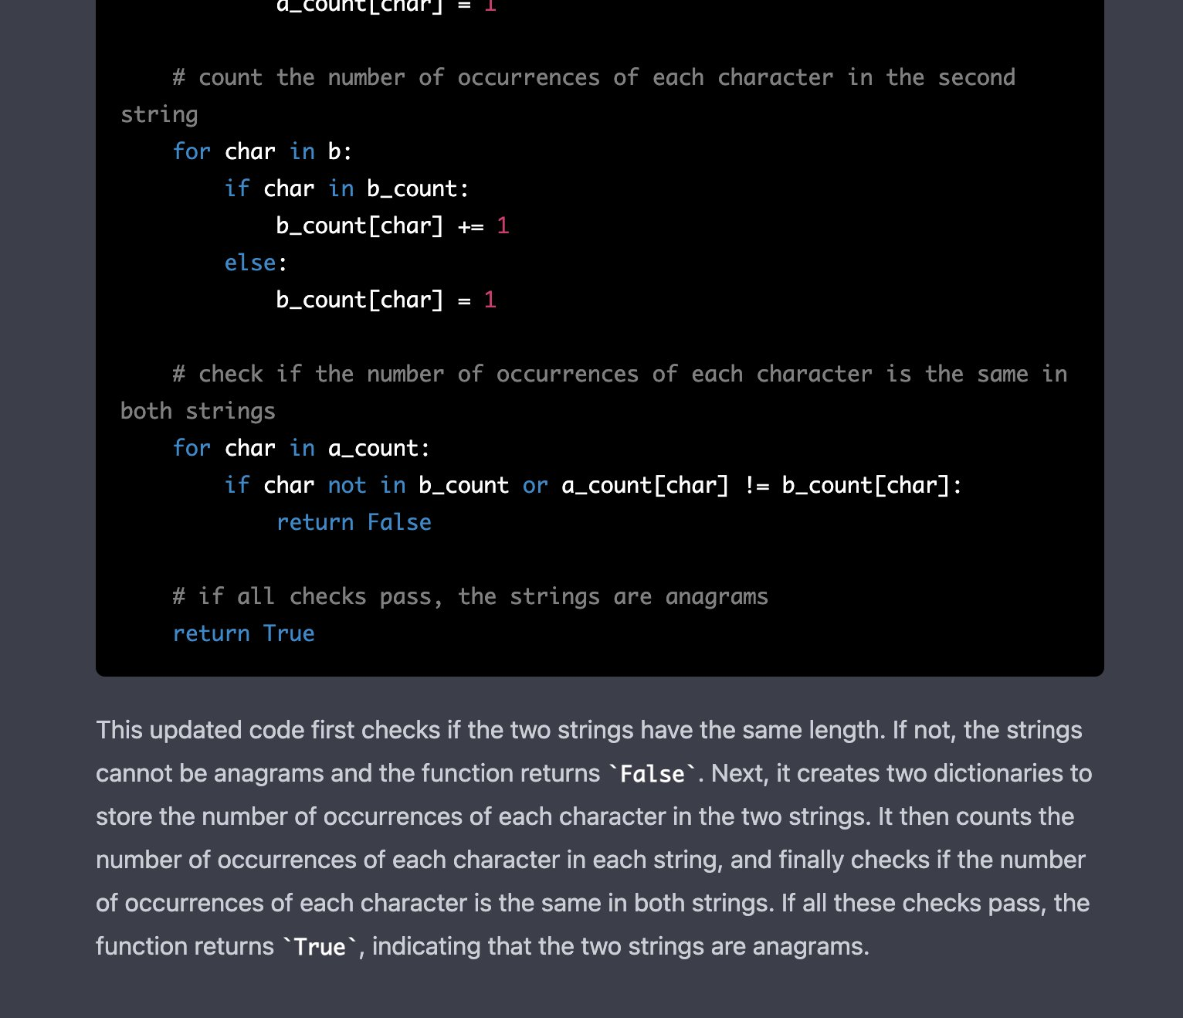

Slide 13
Is Scale All We Need?
Is scale the/a right “hill to climb”?
Even if it is a right “hill” is it feasible/practical to climb this hill? (there might be other “hills” too).

Slide 14
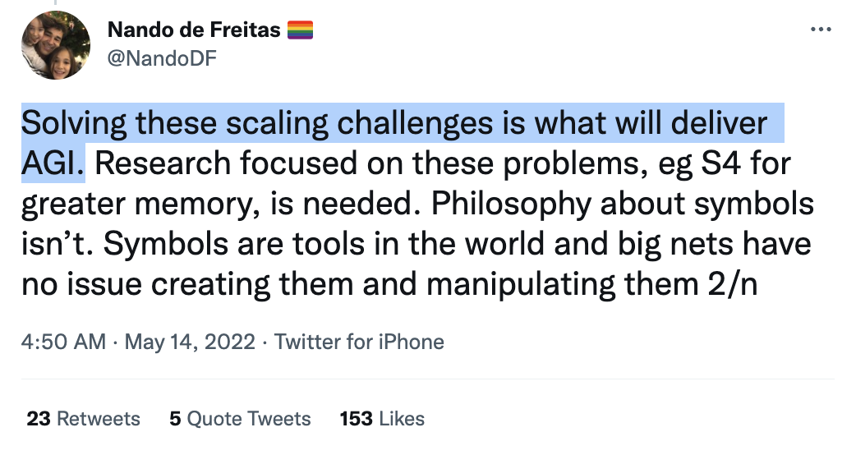
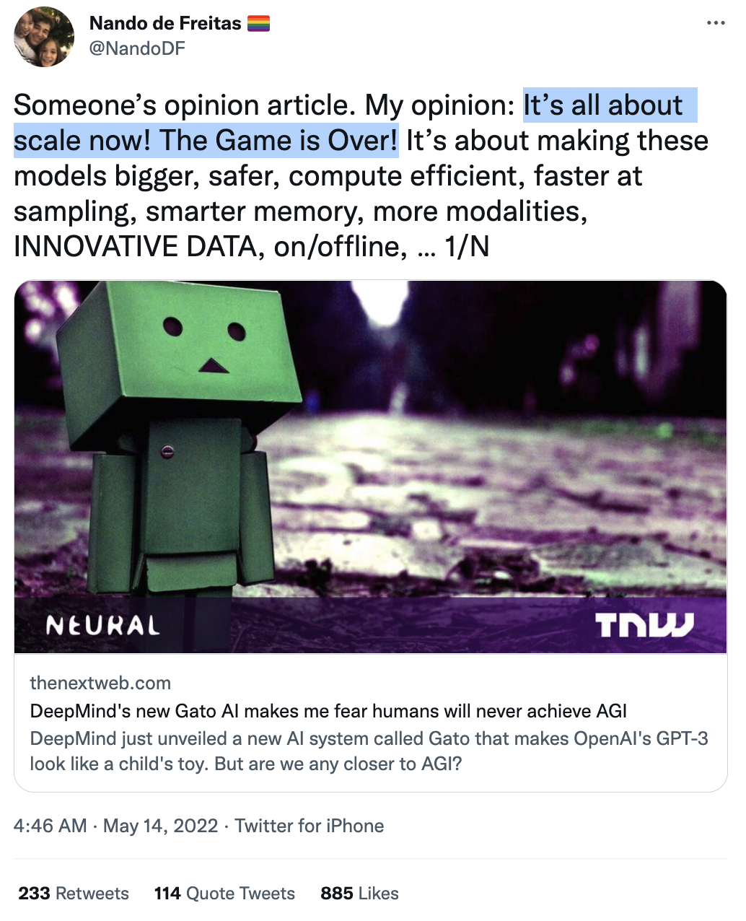
Let’s do a poll!

Slide 15
What is “Scale”
Data? Compute? Information?

Slide 16
Argument for “scale is not all you need”
Hoffmann et al: To be compute-optimal, model size and training data must be scaled equally.
It shows that most LLMs are severely starved of data and under-trained.
Given the new scaling law, even if you pump a quadrillion parameters into a model, the gains will not compensate for 4x more training tokens
There is simply not enough [language] data. [QED]
Training Compute-Optimal Large Language Models. Hoffmann et al,2022

Slide 17
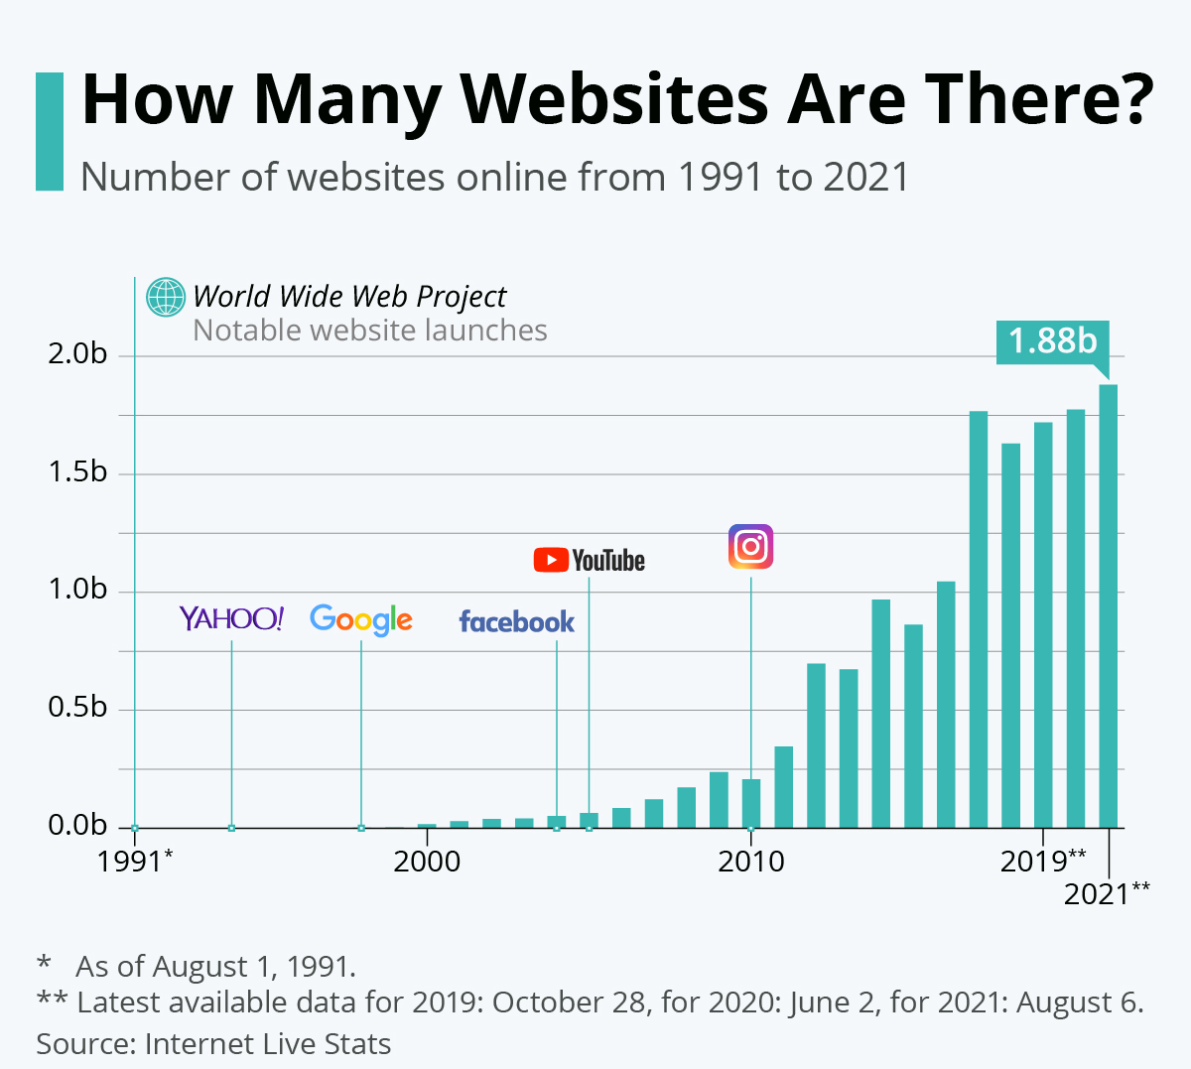
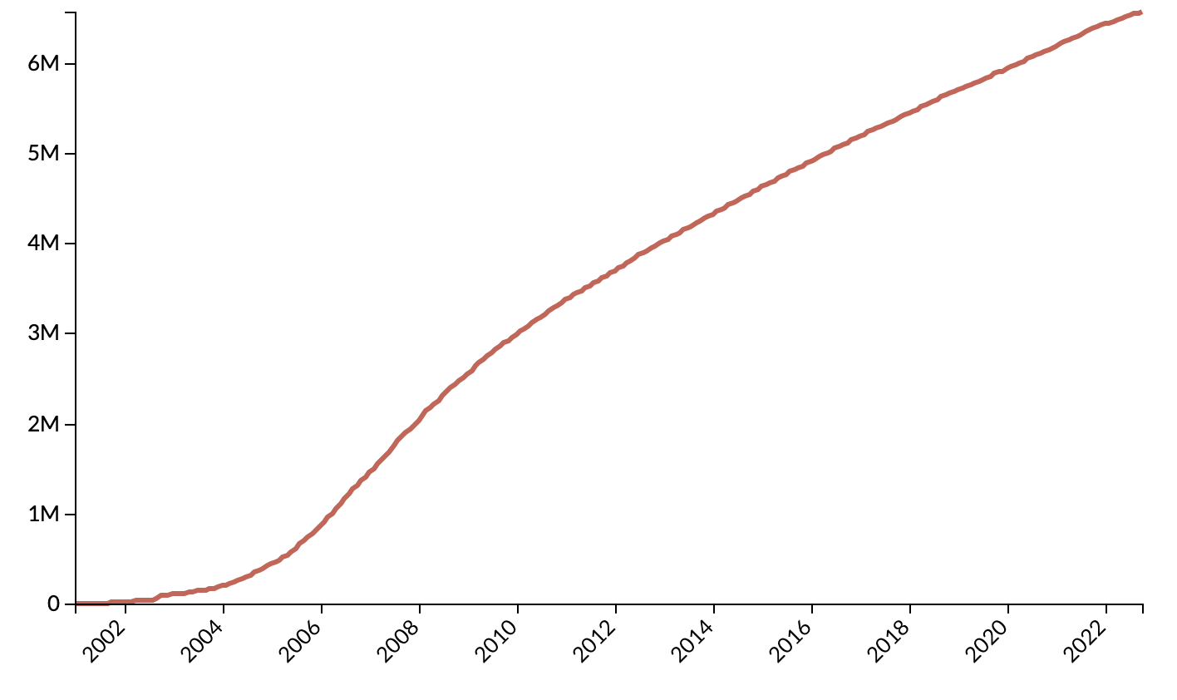
Counter Argument for Not Enough Data (1)
Data is growing exponentially (?)
Wikipedia size

Slide 18

Counter Argument for Not Enough Data (2)
You can harness data from other modalities.
If you want more text, build a solid speech data that converts speech to text.

Slide 19
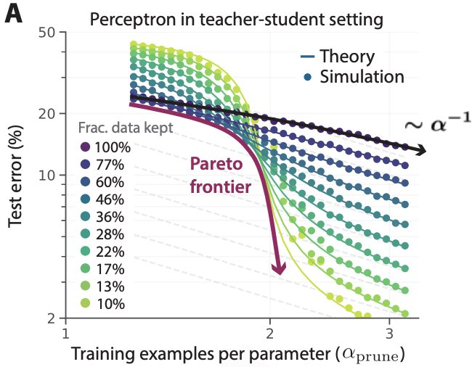
Counter Argument for Not Enough Data (3)
You can use data more effectively.
Sorscher et al. lays out recipes to achieve *exponential* scaling instead through statistical mechanics theory.
Carefully curating a small subset goes a long way!
Beyond neural scaling laws: beating power law scaling via data pruning. Sorscher et al, 2022

Slide 20
Argument for “scale is not all you need”
Argument: There is simply not enough compute available.
Argument: Scaling is quite costly.
Counter-argument: large models might be net-negative.

Slide 21
If “Scale” is All You Need”, is “good prediction” all needed for “general intelligence”?
* self-supervised models == predictive models of the world.

Slide 22














Argument for “scale is not all you need”
Tail phenomena will never go away!
Head tasks:
Translating simple sentences
Generate rhyming sentence
Indicating spans of location
…
popularity
tasks

Slide 23












Argument for “scale is not all you need”
Tail phenomena will never go away!
Tail tasks:
Translation while while retaining rhyme scheme.
Extract all ACL conference chairs since 1990.
Do literature review summarizing human studies on corona viruses.
popularity
tasks

Slide 24
Argument for “scale is not all you need”
Tail phenomena will never go away!
Example: Google Translate
“The number of parallel sentences […] ranges from around tens of thousands to almost 2 billion.”
Massively multilingual neural machine translation in the wild: Findings and challenges. Arivazhagan, Naveen, et al. arXiv 2019.

Slide 25
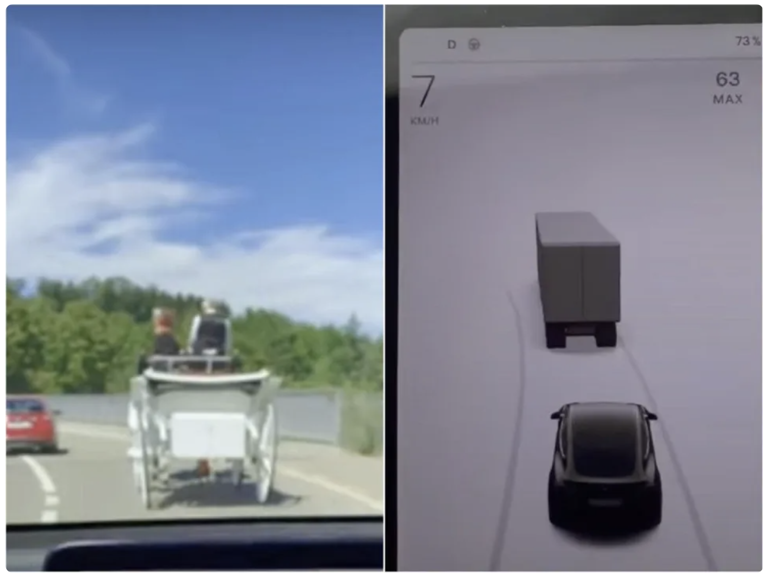
Argument for “scale is not all you need”
Tail phenomena will never go away!
Will result in brittleness to small changes
“Tesla's Autopilot system confusing horse-drawn carriage for truck”

Slide 26
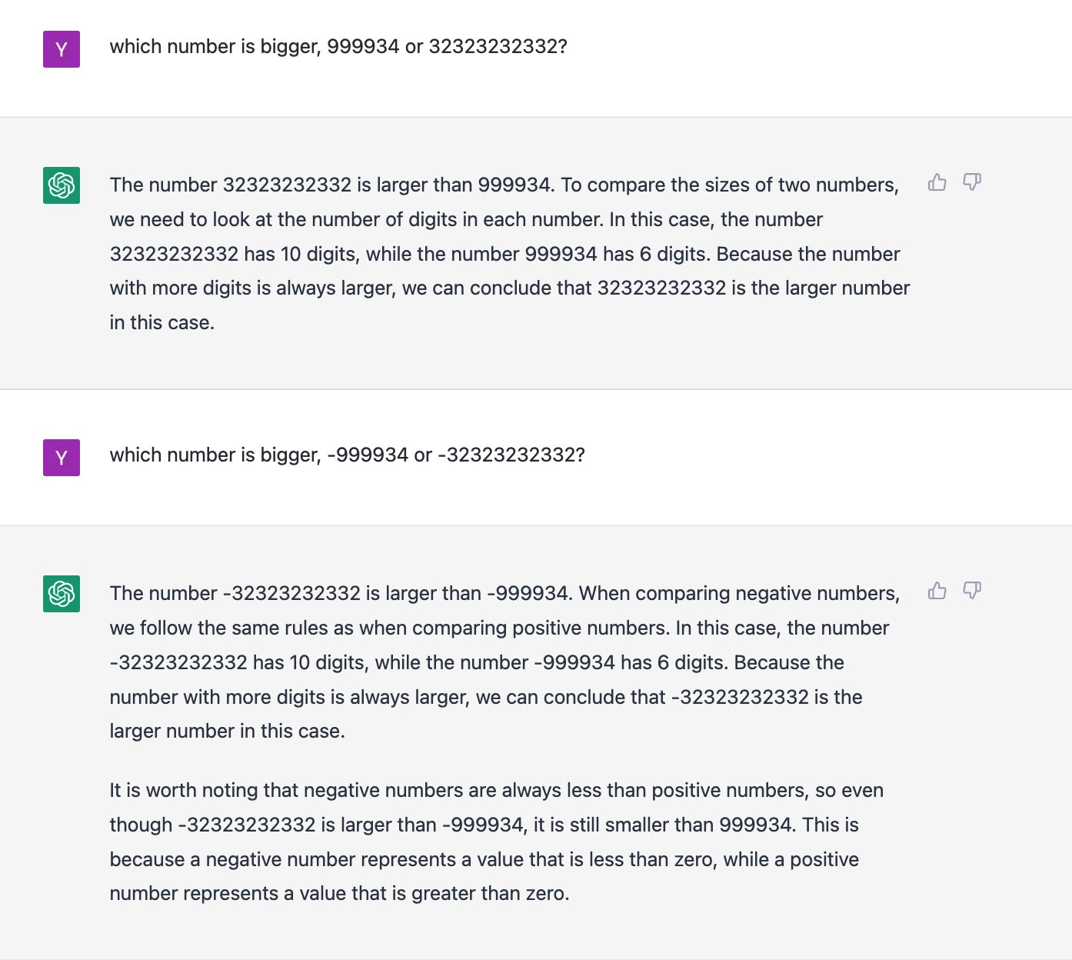

Slide 27
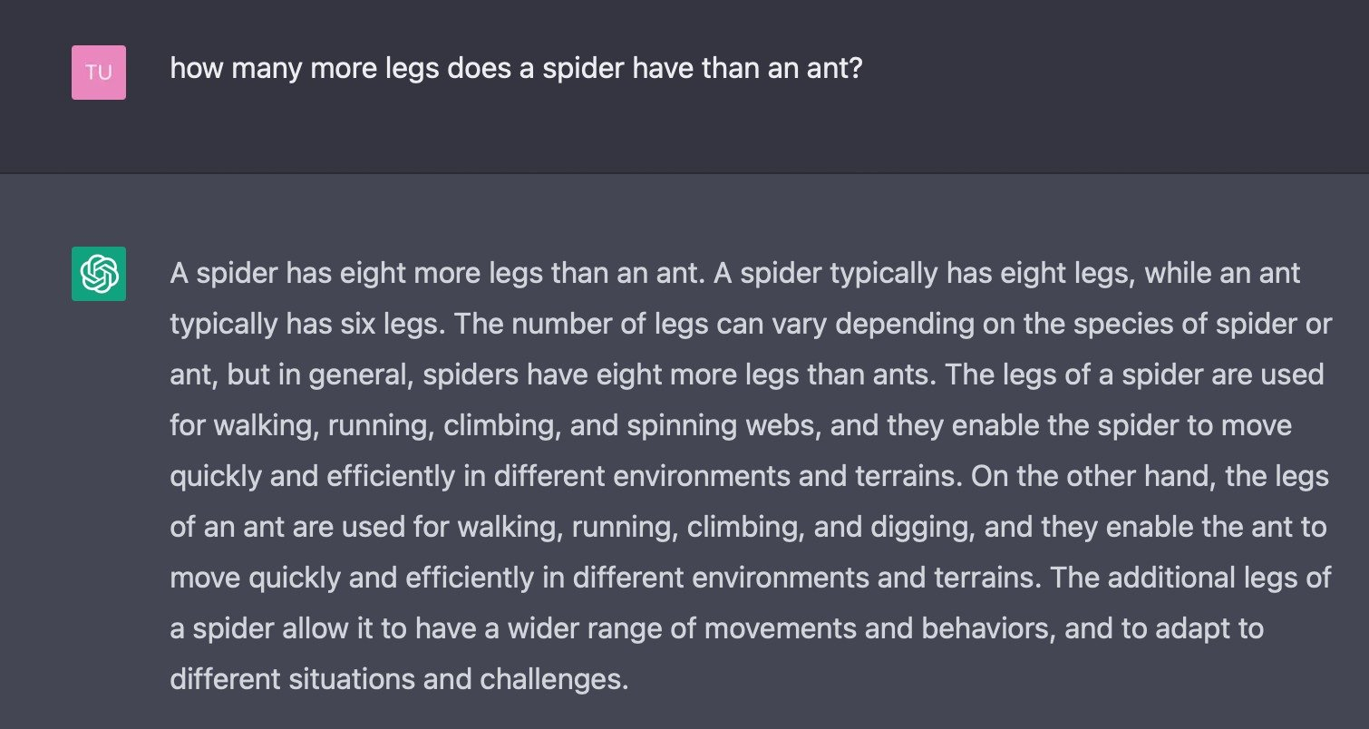

Slide 28
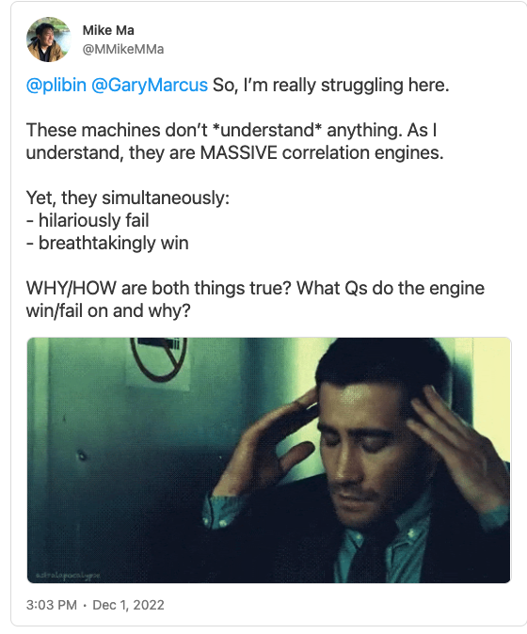
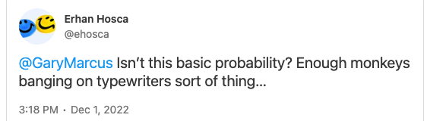
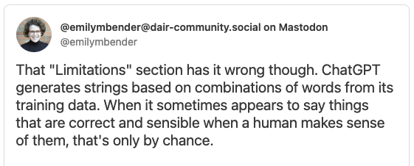
But does it really “understand”?

Slide 29
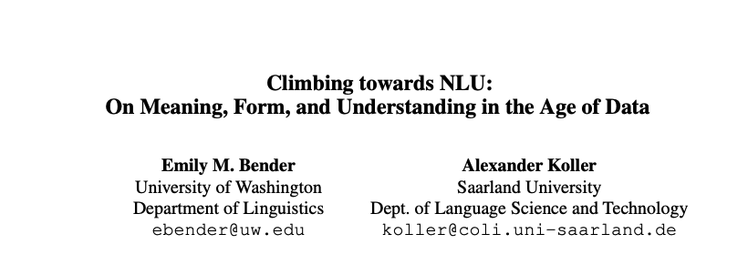
But does it really “understand”?
What is “meaning”?
What is “understanding”?
….

Slide 30
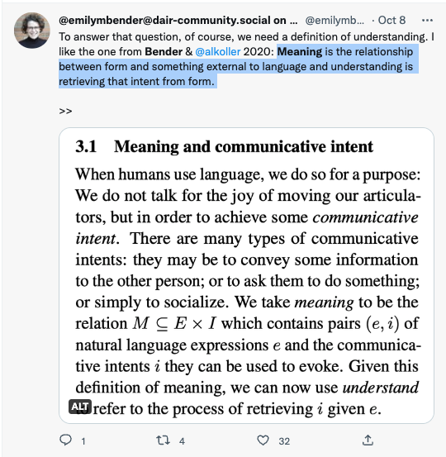
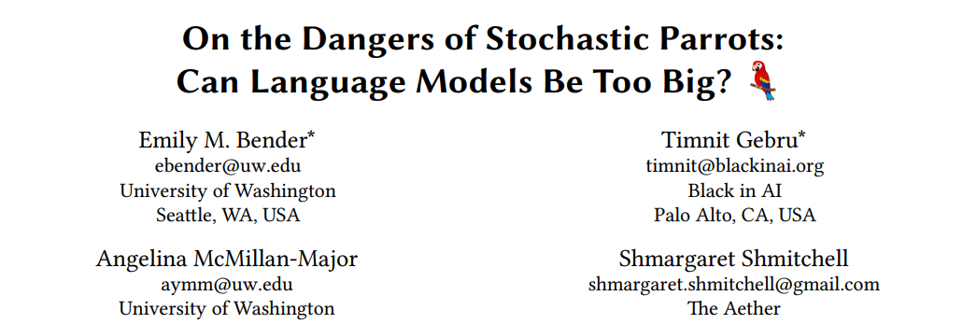
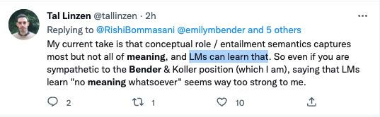
But does it really “understand”?

Slide 31
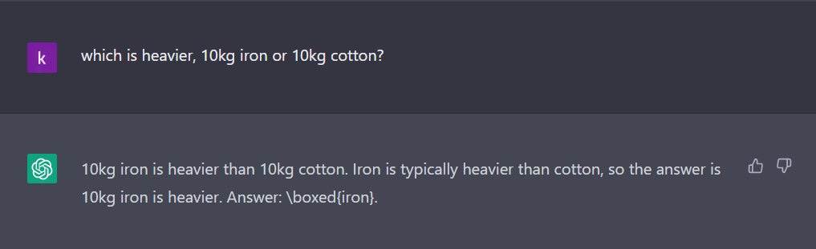
Models are not Grounded in World

Slide 32
Argument against (1)
You can make models grounded in world by training them on grounded data.

Slide 33
Argument against (2)
There are many “intelligent” behaviors in the world that consist of non-intelligent atomic elements.
Every neuron in our body
Every step of evolution

Slide 34
Back full circle: Is Scale All We Need?

Slide 35
How does the future look like to you?
Which future will we have?
One very large model
Few very large models
Many vey large models

